Slide 1


The Cost of Pedestrian Injury in San Francisco
Dahianna Lopez, RN, MSN, MPH
Prevention Director
The San Francisco Injury Center
and San Francisco General Hospital
City Operations and Neighborhood Services Committee Meeting
11 April 2011

Slide 2

San Francisco Injury Center
One of 13 CDC-funded Injury Centers
Affiliated with UCSF School of Medicine
Housed at San Francisco General Hospital
Diverse professional staff
Focus on research, prevention, policy, and education in injury and hospital care

Slide 3
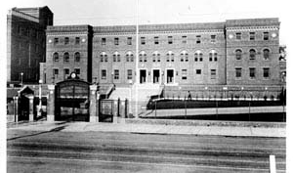
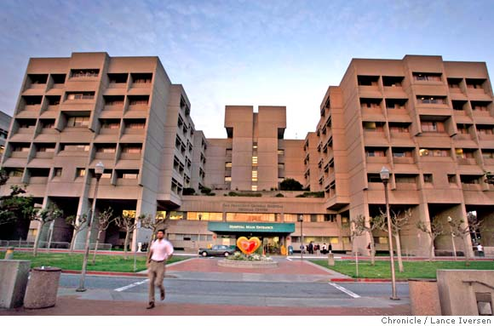
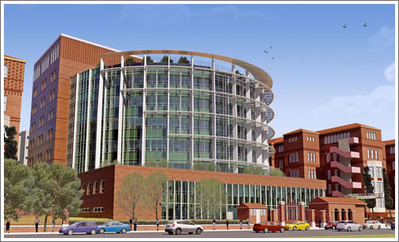
San Francisco General Hospital
San Francisco’s only trauma center
Cares for all patients with traumatic injury in San Francisco, regardless of ability to pay
A unique opportunity to study pedestrian injuries
http://www.sfghf.net/about_sfgh.html
Notes:
Since 1872. Affiliated with UCSF since 1873. The picture on the left is from 1815.

Slide 4
Scope of the Problem
650 – 750 auto-versus-pedestrian (AVP) injuries seen at SFGH yearly ª
Police collision records under-report pedestrian injuries by 21% when compared to hospital records ^{b}
During 2008 alone:
  In San Francisco, 92 injuries / 100,000 people
  Nationwide, 63 / 100,000
  Healthy People 2010 goal, 19 / 100,000 ^{c}
ª Healthy People 2020 Public Meetings, 2009. http://www.healthypeople.gov/hp2020/
^{b} Sciortino et al., 2005. Accident Analysis and Prevention 37:1102-13.
^{c} Dicker et al., 2011. Journal of Trauma, submitted.
Notes:
The rate of pedestrian injury in SF is 4.5x the Healthy People 2010 goal!

Slide 5
Study Findings
3,598 cases found from 1/2004 to 12/2008
  952 (26%) patients admitted to hospital
  2,667 (74%) treated and able to go home
Children (0 – 19y): 14%
Adults (20 – 64y): 72%
Elderly (>65y): 13%

Slide 6
Study Findings
74% lived in San Francisco at the time of injury
7% homeless
<1% tourists
This issue affects primarily the residents of SF

Slide 7
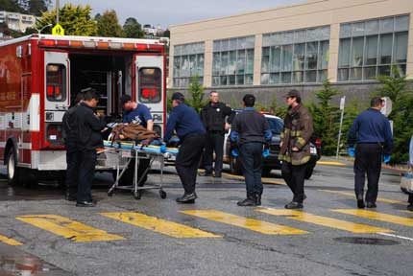

A Day in the Life of an Injured Pedestrian
Step 1: A pedestrian is involved in a collision with a vehicle
Step 2: An ambulance is sent to the scene
$1,200

Slide 8
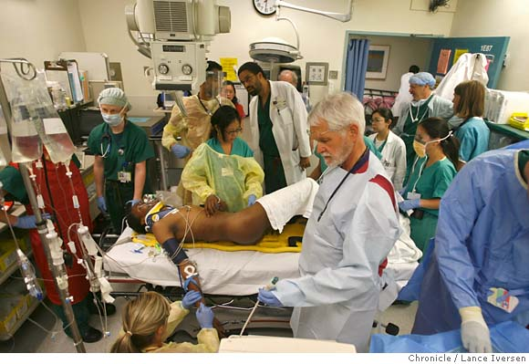
A Day in the Life of an Injured Pedestrian
Step 3: The patient is taken to SFGH, where an interdisciplinary trauma team stabilizes and treats the patient.
$6,405

Slide 9
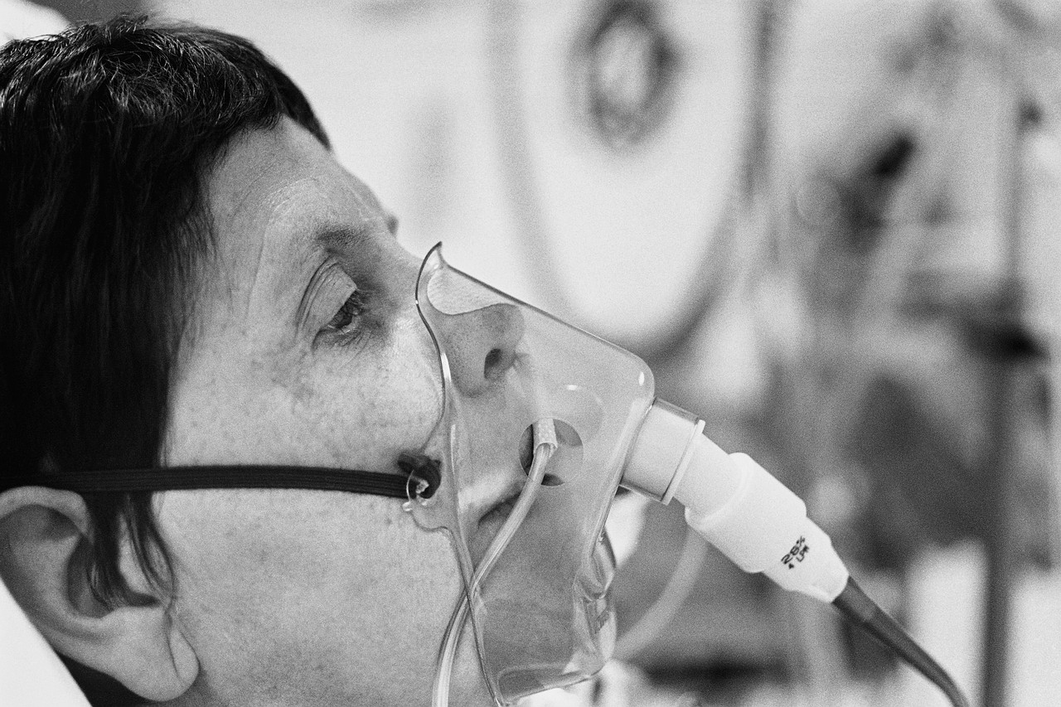
A Day in the Life of an Injured Pedestrian
Step 4: The patient is either treated and is well enough to be released, or is admitted to the hospital for further care.
If admitted…(stay 1 – 2 weeks on average)
$72,754

Slide 10
Overall Costs
Collision Year | Total Cost | Cost per Capita
2004 | $12,819,457.91 | $15.25
2005 | $13,454,205.01 | $16.01
2006 | $16,540,064.94 | $19.70
2007 | $17,636,210.39 | $20.98
2008 | $15,326,148.94 | $18.24
All years | $75,776,087.19 | $90.18
45% charged to MediCal/Medicare
24% charged to private insurance
16% to patients out-of-pocket
Overall, 76% charged to public funds
Cost expressed in 2008 dollars
Notes:
Cost = hospitalization cost + professional fees for operations/procedures + ambulance transport.
Not the same as charge, which is the amount billed…more like the retail price.
Used cost-to-charge ratio (obtained for each fiscal year from SFGH CFO) x hospital charges = hospital cost.
Costs are in 2008 dollars, per capita using 2008 population.

Slide 11
Admitted Patients (Severe Injuries)
Even though admitted patients only account for 25% of the total number of injuries, they account for over 75% of the total cost.
Important to reduce severe injuries for social and economic reasons

Slide 12
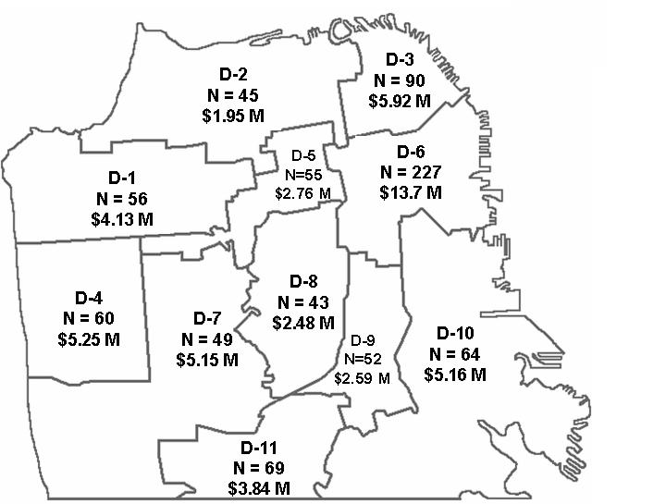
Cost of Admitted Patients by District
Notes:
Out of 952 patients admitted.
D6 accounts for 17% of the total cost… 7x higher than D2 (the lowest cost district)!

Slide 13
Districts 1, 7, 11 (2004 - 2008)
District | Severe Injuries | Death | Medical Costs | Lived in/Injured in District
1 (Mar) | 56 | 7 | $4.1 M | 29%
7 (Elsbernd) | 49 | 2 | $5.1 M | 31%
11 (Avalos) | 69 | 5 | $3.8 M | 54%

Slide 14
Summary
Pedestrian injury in San Francisco is a serious problem in terms of human and economic cost.
The cost of not addressing this issue is economically and socially overwhelming.

Slide 15
Recommendations
Allocate funding to support the pedestrian safety initiatives outlined in the Mayor’s Executive Directive 10-03
Coordination of pedestrian data (injury, cost, environmental, planning, and engineering variables)
Implementation of pedestrian safety countermeasures and initiatives that are informed by data – to have highest impact at locations with the greatest need.
Notes:
Mayor’s ED: 25% reduction in serious & fatal injuries by 2016, 50% reduction by 2021.

Slide 16
Contacts & Acknowledgements
Dahianna Lopez, RN, MSN, MPH
  Prevention Director, San Francisco Injury Center at UCSF
  lopezd@sfghsurg.ucsf.edu
Rochelle Dicker, MD
  Executive Director, San Francisco Injury Center at UCSF
  dickerr@sfghsurg.ucsf.edu
Wendy Max, PhD
M. Margaret Knudson, MD
Marci Pepper
Ian Crane
Matthew Kutcher, MD
Centers for Disease Control and Prevention (CDC)

Slide 18
Study Methods
Used hospital diagnostic codes to identify SFGH hospital visits for pedestrian injury
Excluded San Mateo county injuries
Excluded intentional injuries
Patients divided into ‘admitted’ and ‘non-admitted’
Notes:
20 San Mateo pts and 5 ‘assault with a vehicle’ patients were excluded.

Slide 19
Hospital Stay for Admitted Patients
Average hospital length of stay was 11.6 days
30% of patients required ICU-level care, with an average ICU stay of 2.8 days
55% of patients recovered enough to be discharged home
23% were discharged to another facility
9% died in the hospital
Years of potential life lost: 1,700
Notes:
Transferred: 7% to another acute care facility, 7% to rehab, 19% to SNF.
YPLL was calculated for anyone who died before age 75 (n=65).
Ongoing work to figure out indirect costs of lost productivity.

Slide 20
Cost of Admitted Patients in District 6
Year | Severe Injuries | Deaths | Median Age (y) | Average Hospital Stay (d) | Total Injury Cost
2004 | 50 | 4 | 54 | 8 | $2,298,389
2005 | 52 | 8 | 49 | 6 | $1,684,418
2006 | 44 | 4 | 48 | 18 | $4,469,125
2007 | 46 | 3 | 51 | 13 | $3,141,306
2008 | 35 | 2 | 49 | 11 | $2,124,586
All years | 227 | 21 | 51 | 11 | $13,717,826
72-82% of these costs are charged to public funds such as Medicare, MediCal, and Healthy SF
Cost expressed in 2008 dollars

Slide 21
Location of Injury
Cross-referenced admitted patients with police reports using the StateWide Integrated Traffic Record System (SWITRS) to find location of injury
Between ambulance records and SWITRS, location of injury was found in 77% of 931 admitted patients
Used San Francisco Geographic Information System (SFGIS) to code injuries by district
Notes:
Databases used include the SFGH Trauma Registry, paper EMS record, SFDPH Billing Information System, SWITRS, and SFGIS. SWITRS doesn’t have patient identifiers, so anyone without an intersection on the EMS run sheet was matched by time and date to SWITRS reports.

Slide 22
Pedestrian Injury in District 6
74% of pedestrians injured in San Francisco live in the city at the time of injury
28% of those injured in District 6 live there
36% live elsewhere in San Francisco
As milder injuries not requiring admission were unable to be mapped, the actual cost in District 6 is substantially larger.
Notes:
Median age 51 -> further implications for impact on families and loss of productivity.

